Slide 1



ClusterFL: A Similarity-Aware Federated Learning System for Human Activity Recognition
Xiaomin Ouyang¹, Zhiyuan Xie¹, Jiayu Zhou²,
Jianwei Huang³, and Guoliang Xing¹
¹The Chinese University of Hong Kong, ²Michigan State University,
³The Chinese University of Hong Kong, Shenzhen

Slide 2
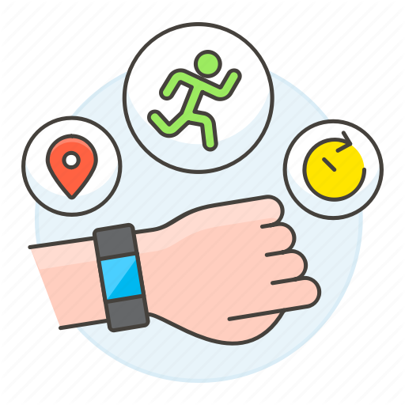

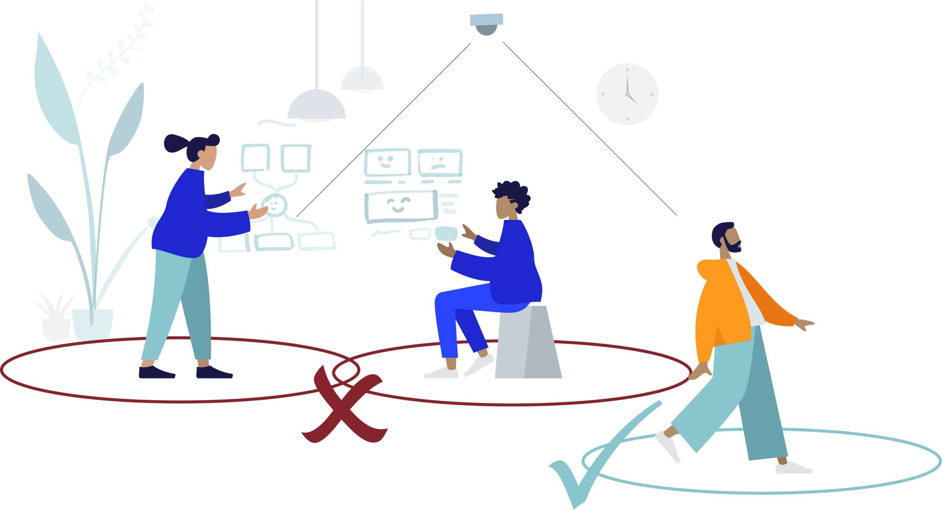
Human Activity Recognition (HAR)
Fitness Tracking
Sleep Monitoring
Social Distancing

Slide 3



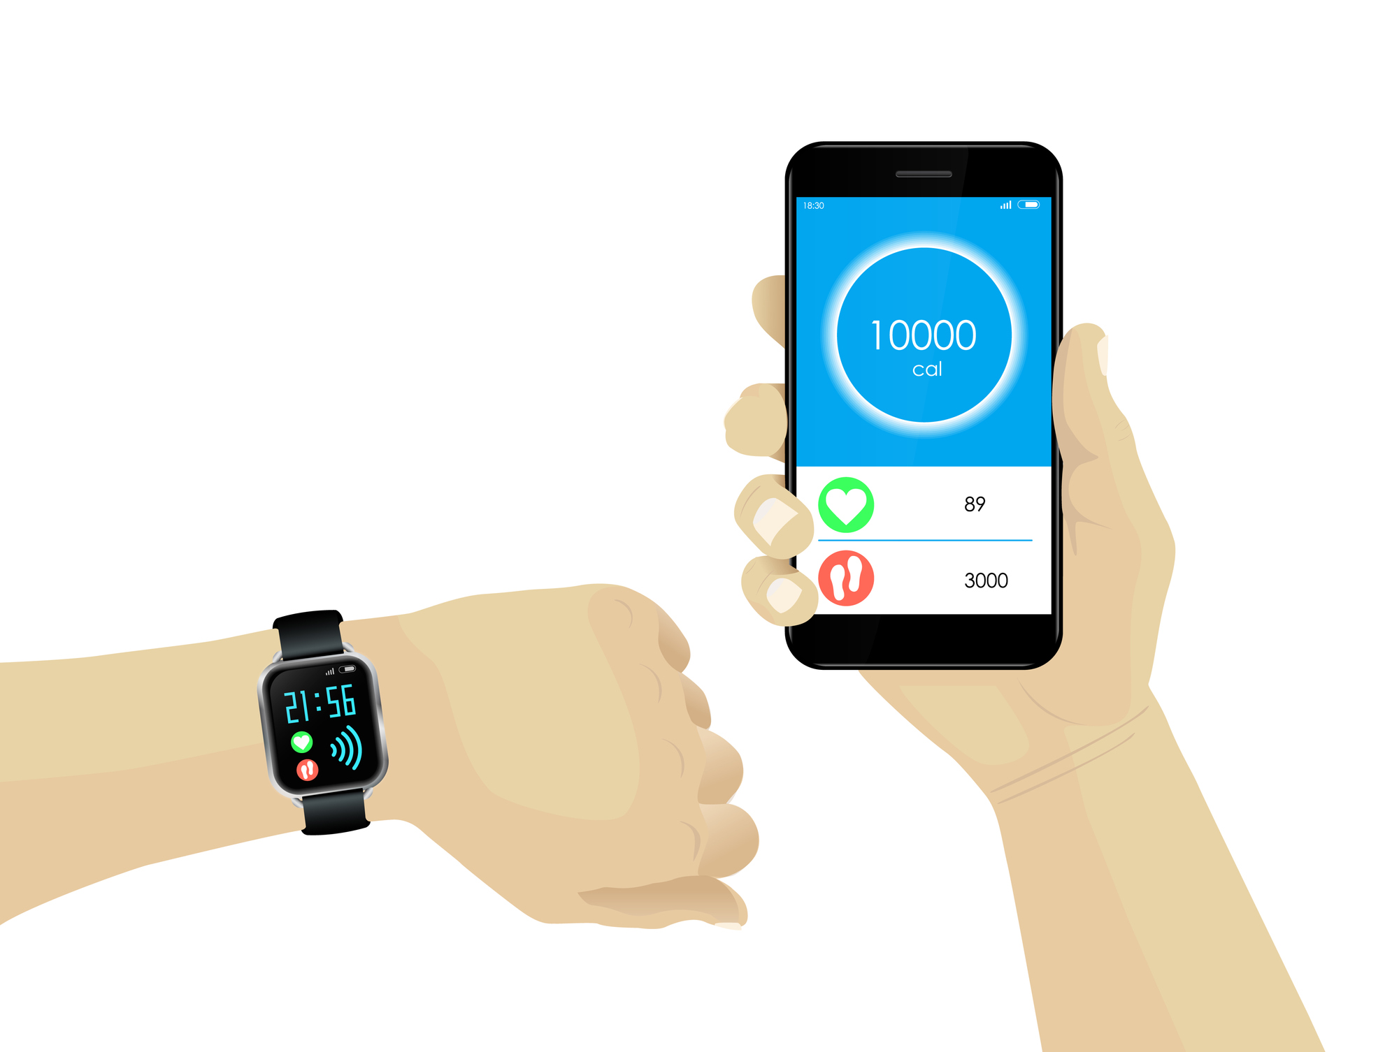

HAR: Current Solutions
Centralized Learning
Significant privacy concern (share raw data).
Server
How about store the data locally?

Slide 4
Federated Learning (FL)
- Enables collaboratively training models while keeping the data residing on devices.
Server
New global model
Not accurate for all users [1][2].
Significant communication overhead.
Model update
[1] Kairouz, Peter, et al. "Advances and open problems in federated learning." arXiv preprint arXiv:1912.04977 (2019).
[2] Yu, Tao, Eugene Bagdasaryan, and Vitaly Shmatikov. "Salvaging federated learning by local adaptation." arXiv preprint arXiv:2002.04758 (2020).

Slide 5


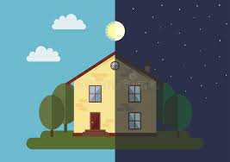
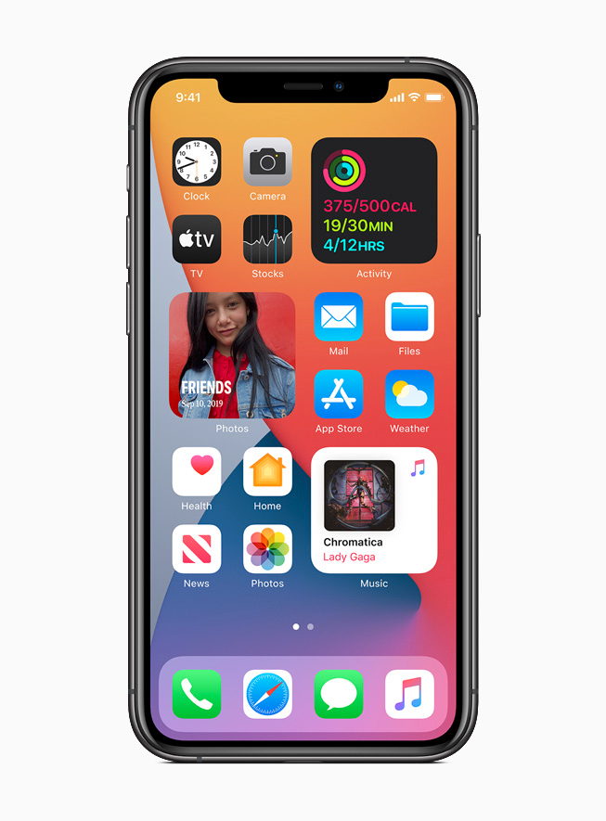
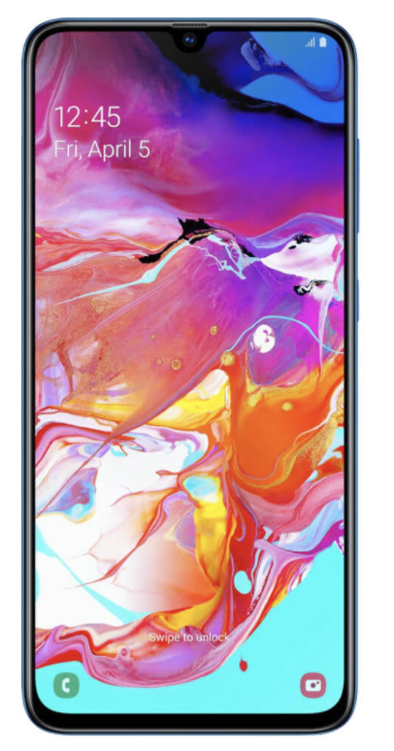
New Insight
There exhibits intrinsic similarities among users’ activity data.
Biological features
Physical environments
Sensor bias
Such similarity can be captured by a cluster relationship.

Slide 6
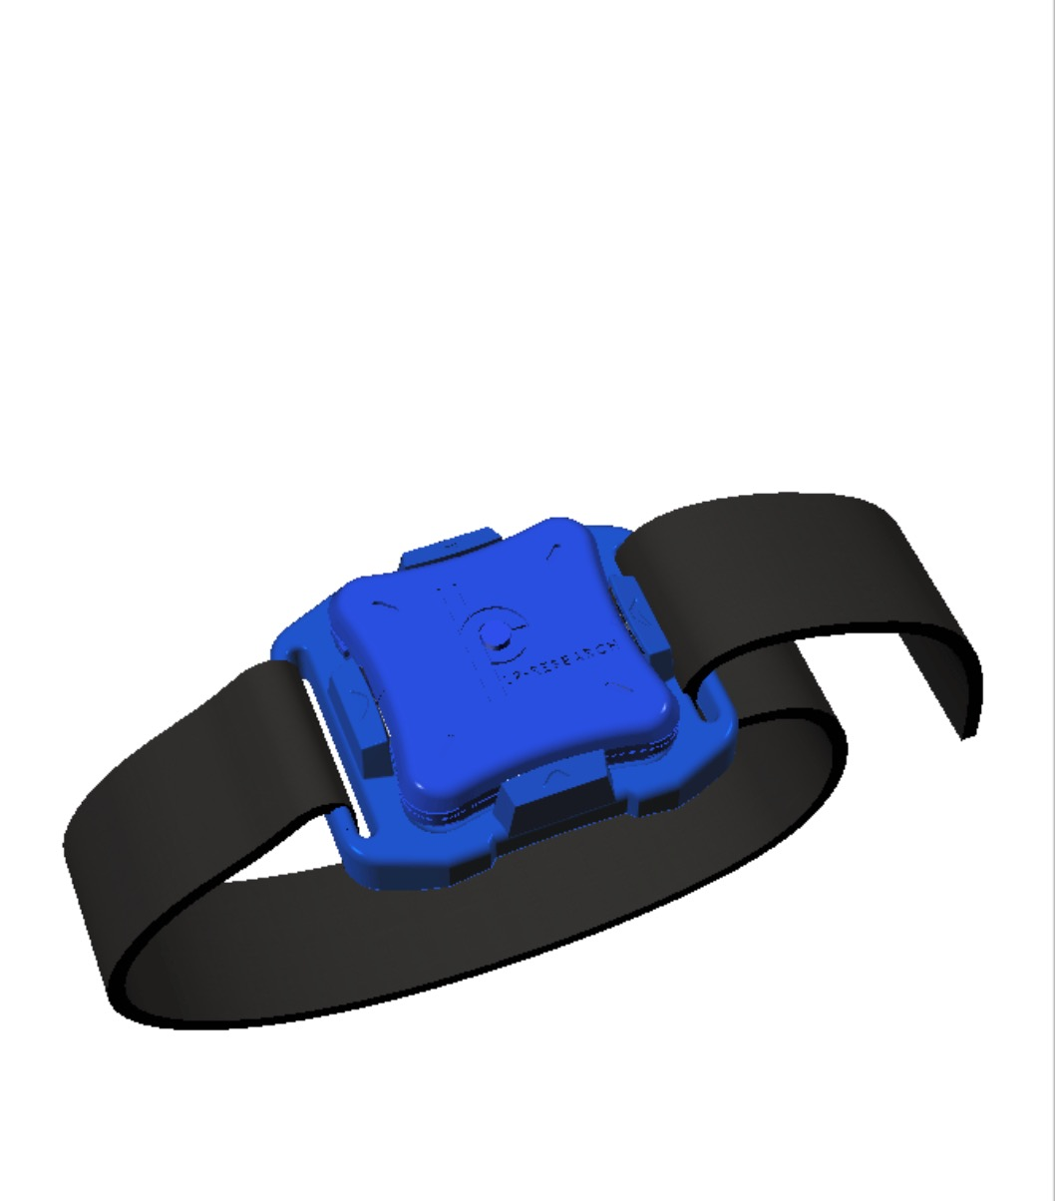
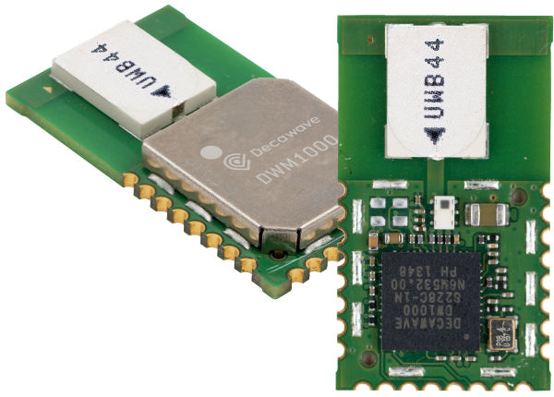
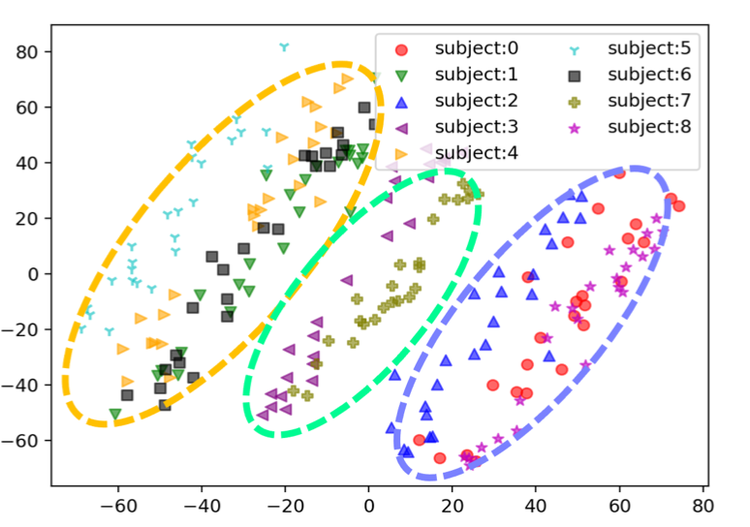
HAR Case Study
Clusterability of Six HAR Datasets (total 180 users):
Datasets
SHAR
HHAR
Depth
IMU
UWB
HARBox
Hopkins statistics (0~1)
0.8813
0.7951
0.8699
0.6966
0.5742
0.8946
Impact of Clusterability on Learning:
Accuracy improvement
Single Global Model | Cluster Models
72.22% | 76.39%
HHAR dataset

Slide 7
ClusterFL: A Similarity-Aware FL System for HAR
Overview:
1. A similarity-aware federated learning framework.
2. Optimizing communication performance.

Slide 8
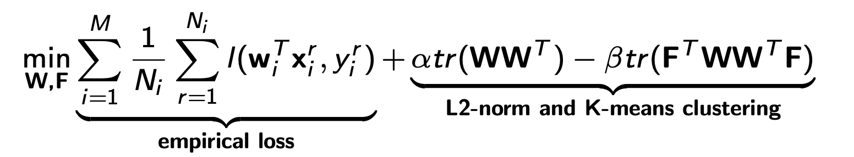
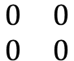
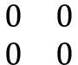
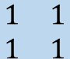
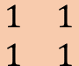
Similarity-Aware FL Framework
W: Model weight matrix
F: Cluster indicator matrix
Problem Formulation:
$$\begin{matrix}1 & 1 \\ 1 & 1\end{matrix}$$
$$\begin{matrix}0 & 0 \\ 0 & 0\end{matrix}$$
$$\begin{matrix}0 & 0 \\ 0 & 0\end{matrix}$$
$$\begin{matrix}1 & 1 \\ 1 & 1\end{matrix}$$
minimize empirical loss on local data.
preserve the similarity of models for nodes in the same cluster.
(x₁, y₁)
w₁
(x_{i}, y_{i})
w_{i}
(x_{M}, y_{M})
w_{M}
Node 1
…
Node i
Node M

Slide 9
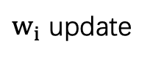
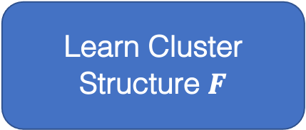
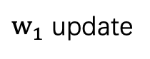
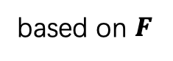
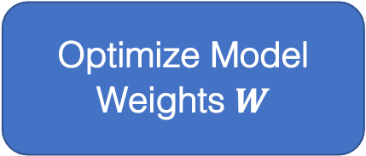
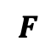
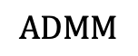
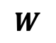
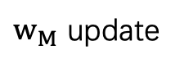
Alternating Optimization
Distributed model update on the nodes.
Optimize Model Weights $W$
$w_{1}$ update
$$ADMM$$
…
W update
based on $F$
$w_{i}$ update
$$F$$
$$W$$
$w_{M}$ update
Learn Cluster Structure $F$
Update using model weights $W$ on the server.
Use the Kullback–Leibler divergence (KLD) of model outputs to measure the similarity of DNN models.
Alternating update between $W$and $F$until convergence.

Slide 10



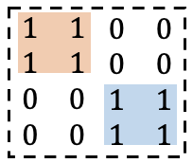

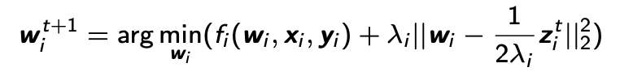
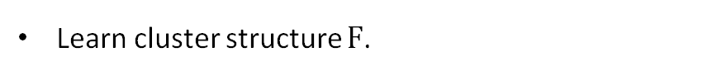
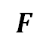
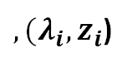
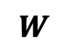
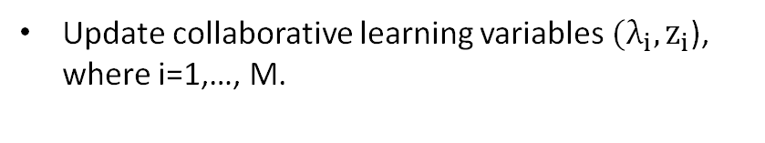
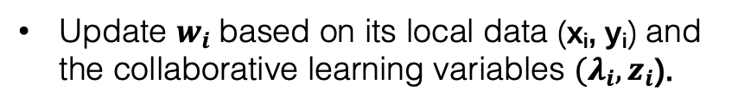
Update Procedure
Server Update:
Learn cluster structure $F$.
$$W$$
$$F$$
$,{(λ}_{i}, z_{i}$)
Update collaborative learning variables ${(λ}_{i}, z_{i}$), where i=1,…, M.
Server
Collaborative learning variables
Node Update:
💪
💪
💪
Update $w_{i}$based on its local data (x_{i}, y_{i}) and the collaborative learning variables ${(λ}_{i}, z_{i}$).
Node 1
…
Node i
Node M

Slide 11
Optimizing Communication Performance
Motivation: The communication latency will increase drastically with the number of participating nodes.
Increase over 10 times

Slide 12
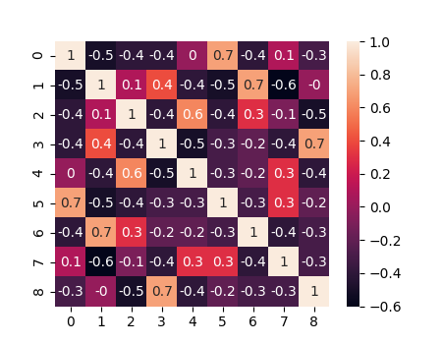
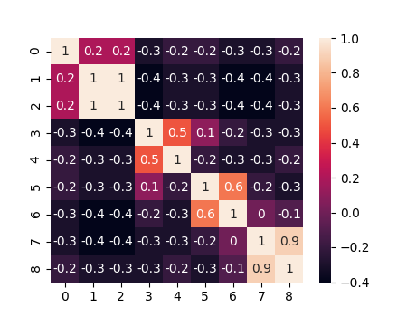
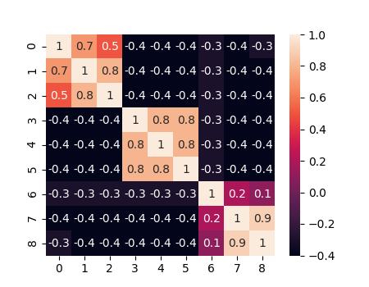
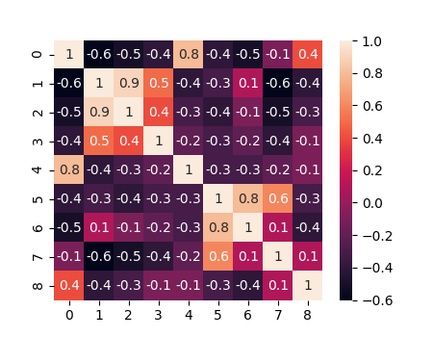
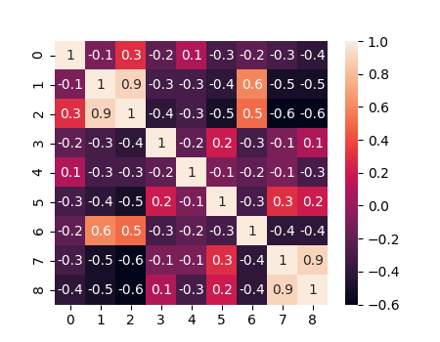
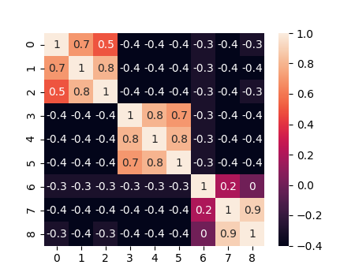

Optimizing Communication Performance
Observation: The cluster structure $F$ can be captured early, i.e., after updated several times.
Change of F
0
4
8
12
16
20
Iteration
Utilizing the learned cluster relationship to intelligently drop nodes during the FL process.

Slide 13
Optimizing Communication Performance
Mechanisms: Cluster-Wise Straggler Dropout
75
85
85
Drop one straggler among all nodes
Drop two stragglers within clusters
Identify and drop stragglers within each cluster rather than from all nodes.

Slide 14
Optimizing Communication Performance
Mechanisms: Correlation-based Node Selection
Drop the less related nodes within each cluster.

Slide 15
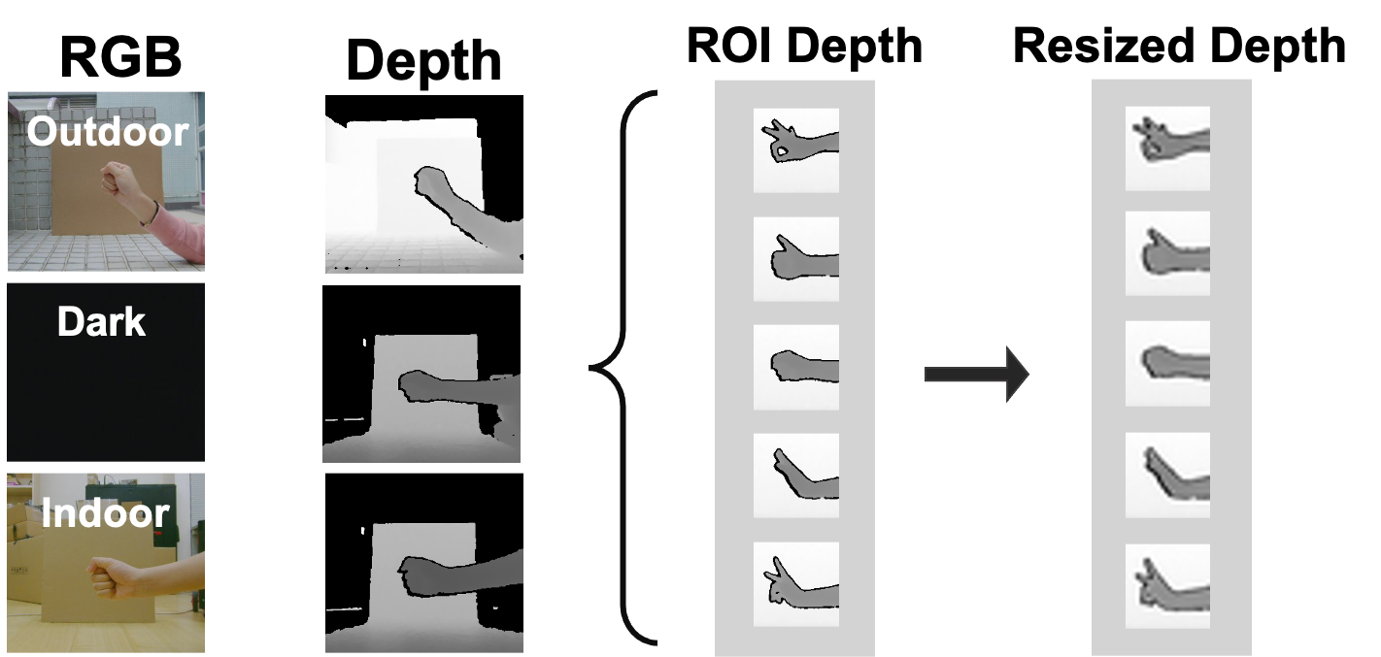
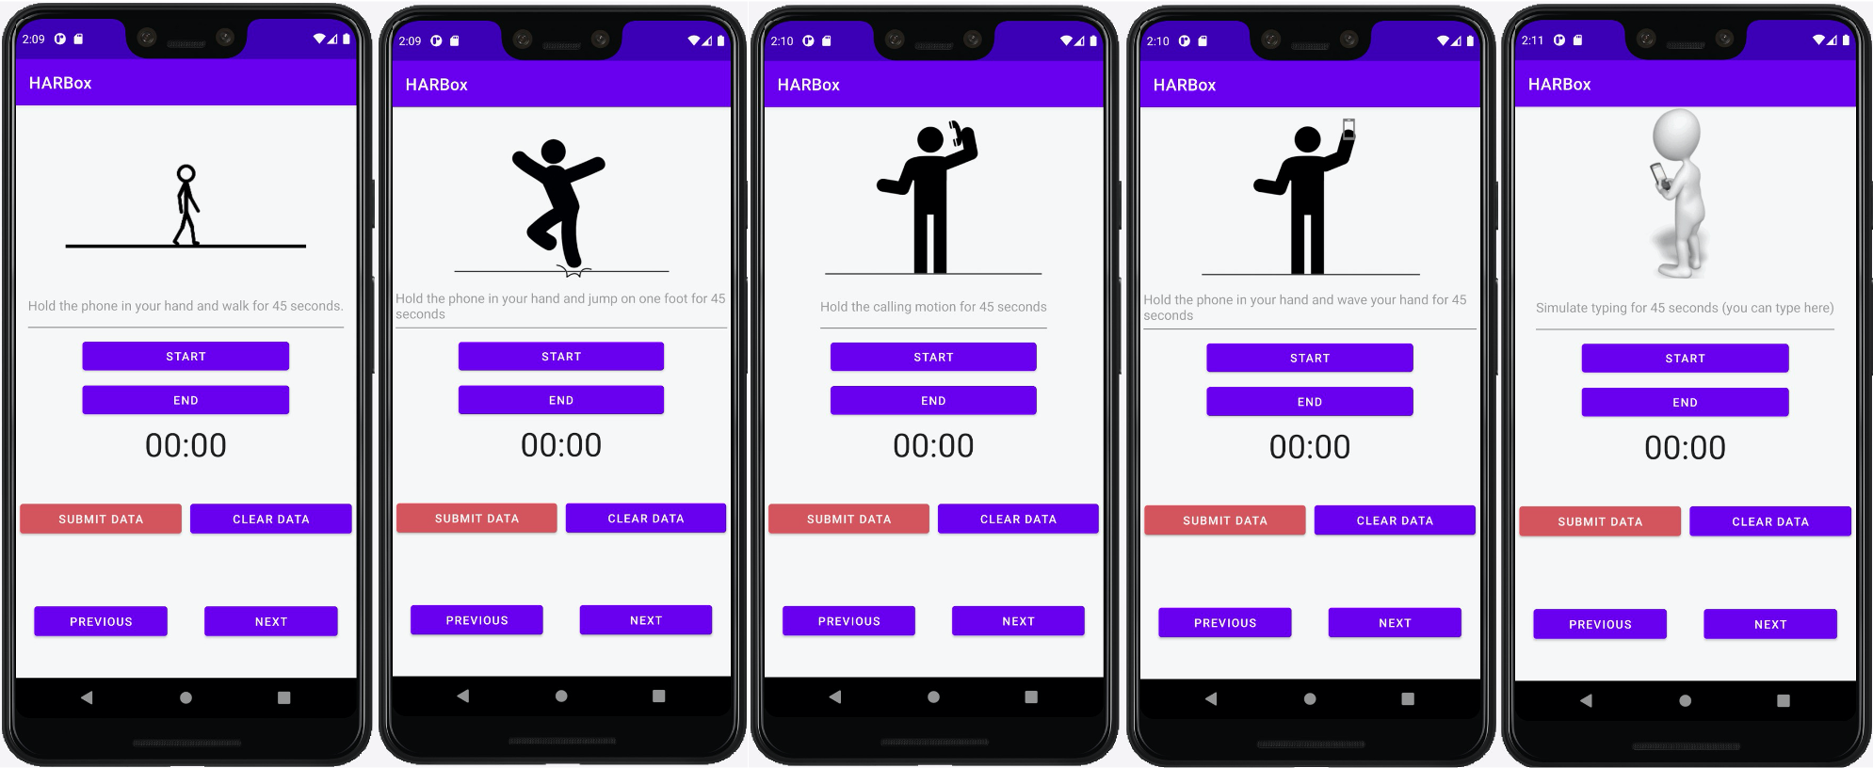
Experiment Setup
Four new HAR datasets collected from total 145 users:
UWB
IMU
Depth camera
An Android App collects 9-axis IMU data of users’ smartphone.
Recordings from 121 users with 77 different smartphone models.
HARBox

Slide 16
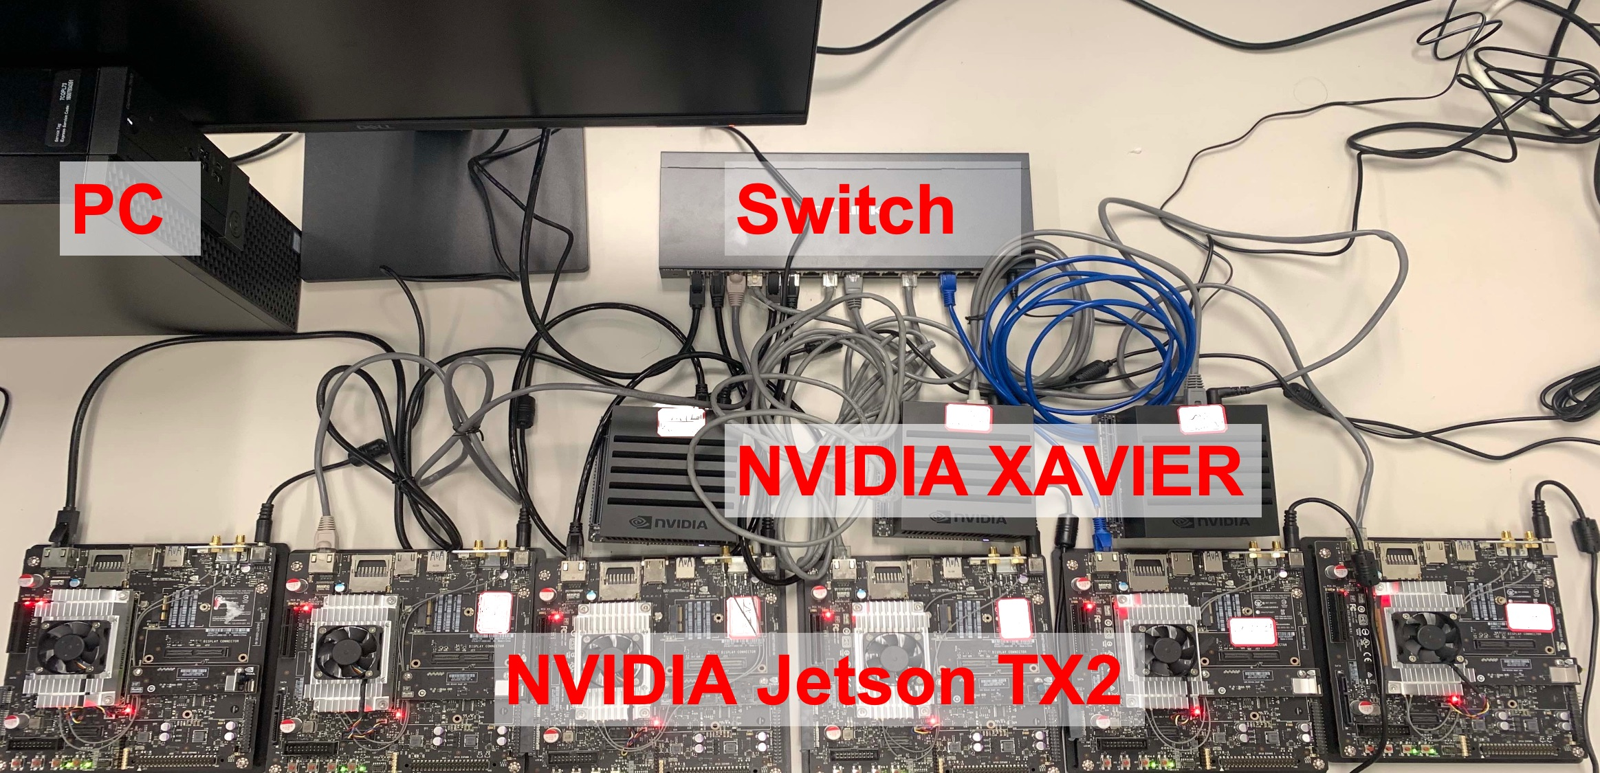
Experiment Setup
Testbed :
Baselines :
FedAvg (Federated Averaging)
FTL (Federated Transfer Learning)
Centralized learning

Slide 17
Evaluation: Robustness
4G: lower and unstable bandwidth.
Dynamic Network Conditions:
WiFi (50-100 Mbps) and Ethernet (400-600 Mbps).
4G LTE.
Nodes (from 4G) are dropped.
Performance:
The testing accuracy increases steadily.

Slide 18
Evaluation: Effectiveness and Scalability
With the number of nodes increasing:
Improve model accuracy for most nodes.
Save over 50% communication time.

Slide 19
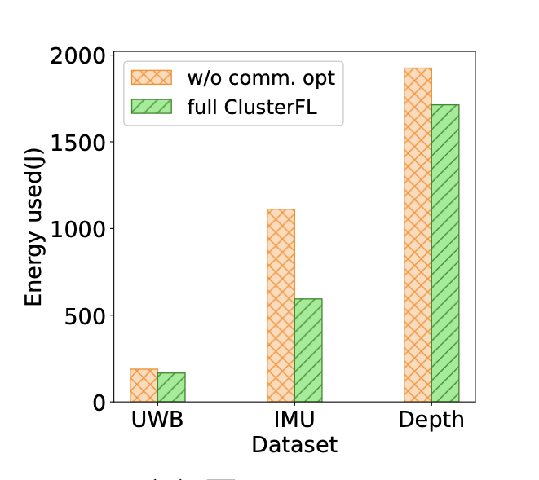
Evaluation: Different Datasets
by 6.46% to FedAvg and 5.41% to FTL
On UWB, IMU and Depth datasets:
 | FedAvg | FTL | ClusterFL
UWB | 86.25% | 87.30% | 92.71%
IMU | 82.00% | 86.20% | 89.05%
Depth | 63.75% | 63.86% | 70.68%
Outperform several learning paradigms.
Model accuracy
Save significant energy consumptions at the expense of minor accuracy reduction.
50%
Effectiveness of comm. optimization

Slide 20
Conclusion
ClusterFL: A similarity-aware federated learning system for human activity recognition.
Utilize the intrinsic cluster relationship of user data to improve the model accuracy.
Propose two new mechanisms to optimize communication overhead.
Future work
The trade-off between privacy and utility for correlated users in FL.
Extend ClusterFL to a wider range of applications.
Apply ClusterFL to FL systems with other network topologies.

Slide 21

Thanks!
ClusterFL: A Similarity-Aware Federated Learning System for Human Activity Recognition
Xiaomin Ouyang, Zhiyuan Xie, Jiayu Zhou, Jianwei Huang, and Guoliang Xing
http://aiot.ie.cuhk.edu.hk/Details_Federated.html

